Slide 1
Introduction to OOAD
CSCI 4448/5448: Object-Oriented Analysis & Design
Lecture 2

Slide 2
Acknowledgement & Materials Copyright
I’d like to start by acknowledging Dr. Ken Anderson
Ken is a Professor and the Chair of the Department of Computer Science
Ken taught OOAD on several occasions, and has graciously allowed me to use his copyrighted material for this instance of the class
Although I will modify the materials to update and personalize this class, the original materials this class is based on are all copyrighted © Kenneth M. Anderson; the materials are used with his consent; and this use in no way challenges his copyright

Slide 3
Learning Objectives
Clarify the class focus and relevance
Determine the class fit to the student’s learning goals, experience, and skills

Slide 4
Welcome!
Welcome to Object-Oriented Analysis and Design (aka OOAD)
I’m looking forward to working with you!
This course explores Object-Oriented principles, patterns, theory, development languages, methods, processes, and related topics
It’s intended to give you a set of core design skills for use in designing and developing OO systems
Look hard at the material we cover, and we’ll talk about whether this course is right for you

Slide 5
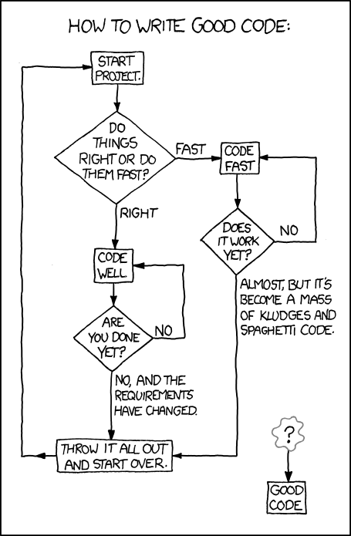
Good Code
This class teaches a style of software design that can help you reach the box labelled “Good Code”…
Software Design is not completely a black art… there are design techniques that lead to better results when applied in support of creative expression.
From the excellent web comic, xkcd: <http://xkcd.com/844/>

Slide 6
Prerequisites
Programming skill is required
My lectures will primarily use Java examples (like the textbook)
I will include Python examples for most things as a counterpoint
Your class exercises will be primarily required to be in Java, but other languages may be used in certain cases
I don’t generally ask you to write code on exams, but I may ask for pseudo-code, so again, programming needs to be a skill you have
Most other things you need to know, we’ll review a bit – like Git, for instance – and I will provide resources for your external review
If you have a couple years of programming experience, Java (and Python) are high level languages that shouldn’t be hard for you to learn, but…
You’ll learn the tools on your own. My lessons will be focused mostly on the OO features of the languages. This is not a Java or Python programming class.

Slide 7
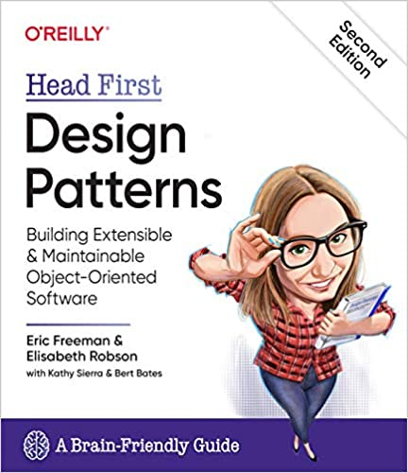
OOAD Class - Textbook
Textbook:
Head First Design Patterns
By Freeman, Robson, Bates, & Sierra
O’Reilly
2nd Edition – 2020
I will be visiting most of the Java-based content in this book
There will be other materials I will point you at as needed
Readings will be required, and key elements will show up on quizzes and exams
If you’re going to stay in OOAD, get access to the book
It is available in the O’Reilly e-books in the CU Library!

Slide 8
OOAD Class Focus
Patterns we will cover in detail:
Strategy
Observer
Decorator
Simple Factory, Factory, Abstract Factory
Singleton
Command
Adapter, Façade
Template
Iterator, Composite
State
Proxy
MVC and Variations
Patterns we will visit with:
Bridge
Builder
Flyweight
Interpreter
Mediator
Memento
Prototype
Visitor
Quick review of OO basics
Quick visits to Git, Java, Python, UML
Large part of class: OO patterns (right) and OO principles (next page)
Other topics (coverage depends on pace of above)
Design Techniques
Architecture
OR Mapping
Dependency Injection
Refactoring and Code Smells
Reflection
Test Driven Development
Software Project Management
Other TBD…

Slide 9
OO Principles
S O L
I
D
A class should have only one reason to change (Single Responsibility Principle)
Classes should be open for extension, but closed for modification (Open-Closed Principle)
Superclass objects should be replaceable by subclass objects without breaking functionality (Liskov Substitution Principle or LSP)
Clients should not depend on methods in an interface they don’t use (Interface Segregation Principle)
Depend on abstractions, not concrete classes (Dependency Inversion Principle)
Encapsulate what varies
Favor composition (delegation) over inheritance
Program to interfaces not implementations
Strive for loosely coupled designs between objects that interact
Only talk to your (immediate) friends (Law of Demeter, Principle of Least Knowledge)
Don’t call us, we’ll call you (Hollywood Principle)
Classes are about behavior, not specialization
Don’t repeat yourself (DRY Principle)
You Aren’t Going to Need It (or You Ain’t Gonna Need It) (YAGNI)

Slide 10
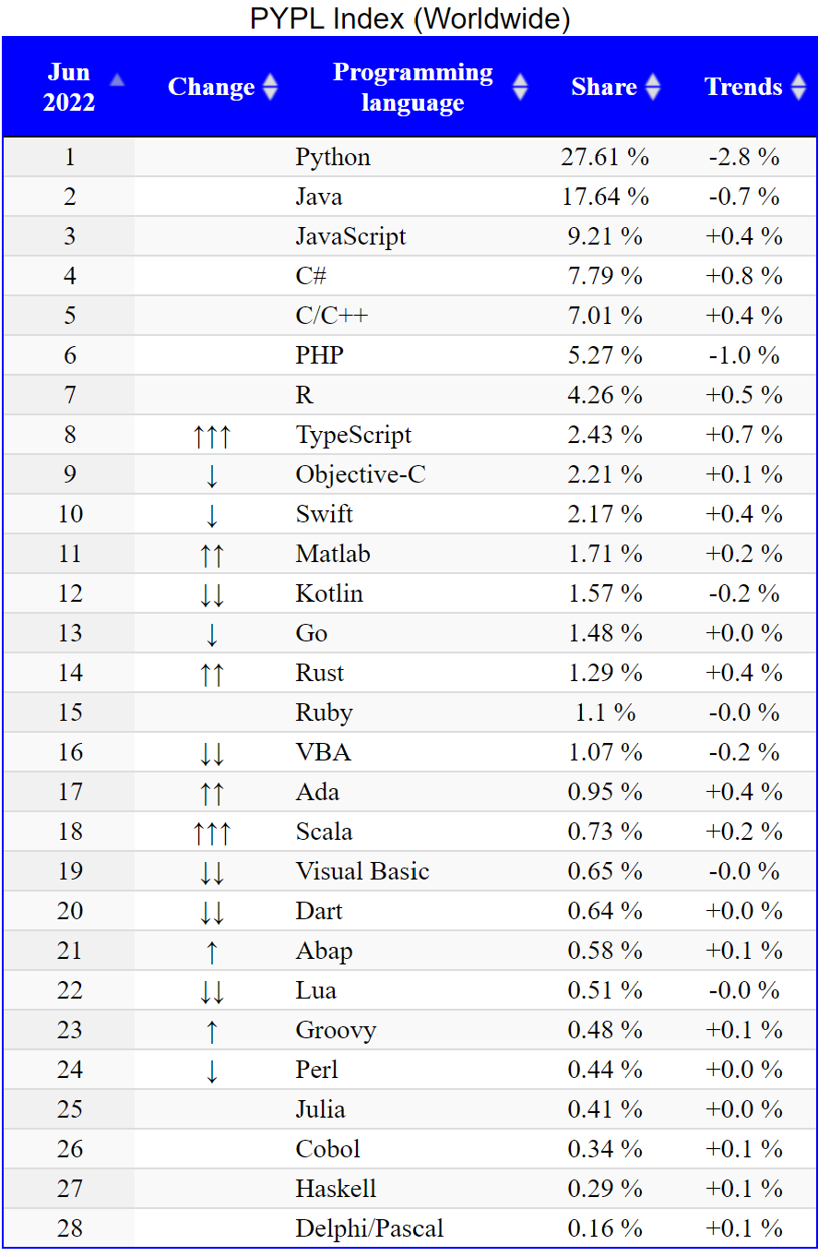
OO Relevance
PYPL Top 4
Python, Java, JavaScript, C#
TIOBE Top 4
Python, C, Java, C++
Most popular languages are OO (at least in part)
June 2022
http://statisticstimes.com/tech/top-computer-languages.php

Slide 11
Summary: Goals of the Class
Tools for your programming tool kit!
Provide students with knowledge and skills in:
Object-oriented concepts and patterns
OO analysis, design and implementation techniques
OO design methods (software life cycles)
Students should view OO software development as a software engineering process that has well-defined stages with each stage requiring specific tools and techniques
You will also gain experience with OO programming, hopefully with languages you’re interested in learning
And you’ll be better prepared for both new development and supporting legacy code

Slide 12
What should I review? (Optional)
It's NOT required, but if you want to do a little preparation for the class, here's a few things I'd recommend:
Shortly, we will do an intro to OO (which we'll dig into all semester) and talk about Git, Java, and Python (which I don't teach in depth) - I expect you to pick up tools and languages as we go
OO: We will review this, but you should know the basics of what object-oriented languages are – a good resource is the first chapter of: The Object-Oriented Thought Process, 5th Edition by Weisfeld
Git: If you're not Git savvy, look at a tutorial like https://guides.github.com/activities/hello-world/ or the Pro Git book (found at https://git-scm.com/book/en/v2)
Java: If you haven't used Java (the main development language for the class), I'd look for an online tutorial (like https://docs.oracle.com/javase/tutorial/) or take a look at a book like: Java: A Beginner's Guide, Eighth Edition, 9th Edition by Schildt
Python: We also discuss Python, although we use it less - if you haven't Python-ed much, again look at an online tutorial (like https://docs.python.org/3/tutorial/) or a book like: Head First Python, 2nd Edition by Barry
The books are available as e-books online at the CU library site: https://libguides.colorado.edu/strategies/ebooks (use search or the sciences tab, then O'Reilly-Safari eBooks)

